Slide 1

WELCOME TO QUALITY EXPERTS GROUP
Software Training Institute & Consultancy

Slide 2

SELENIUM IDE
Selenium-IDE Introduction
Installation /download Selenium–IDE (Firefox)
Installation /download Selenium–IDE (Google Chrome)
Characteristics of Selenium-IDE
First test case of Selenium-IDE
Login test for Selenium-IDE
Selenium-IDE commands
Selenium-IDE locators
Id locator
Name Locator
X Path Locator
CSS Selector Locator
Locating by ID
Locating by Class
Locating by Attribute
Locating by ID/Class & Attribute
Advantage and Disadvantage of Selenium-IDE
KEY TAKEAWAYS

Slide 3
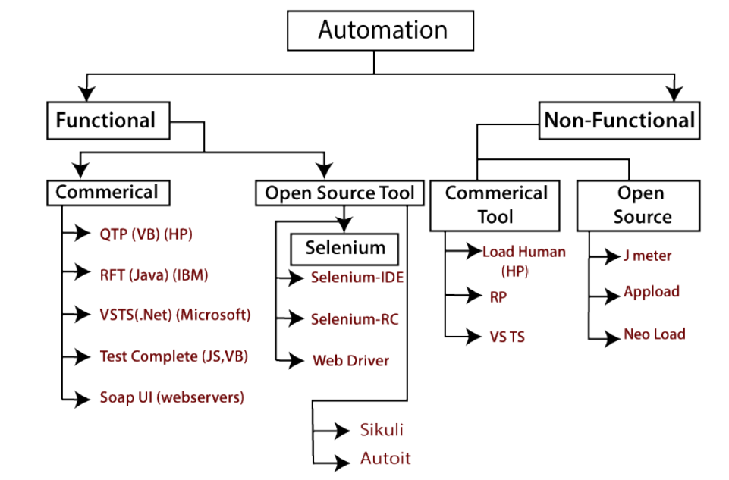
TEST TOOLS
Functional Automation Testing
To automate the functional test cases, test engineer use functional automation testing.
e.g.-: Repetitive Regression tests are automated.
Non-functional Automation Testing
To automate the non-functional performance test cases.
e.g.-: Checking the response time of the application under considerable (say 100 users) load.

Slide 4
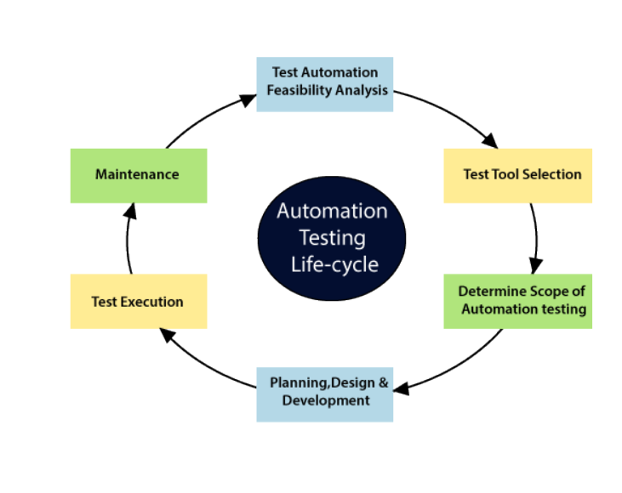
AUTOMATION LIFE CYCLE
Automation Testing:
Process of converting manual test cases into a test script using automation tools, and scripting or programming language
Advantages:
Time Saving
Batch Execution
Reused

Slide 5
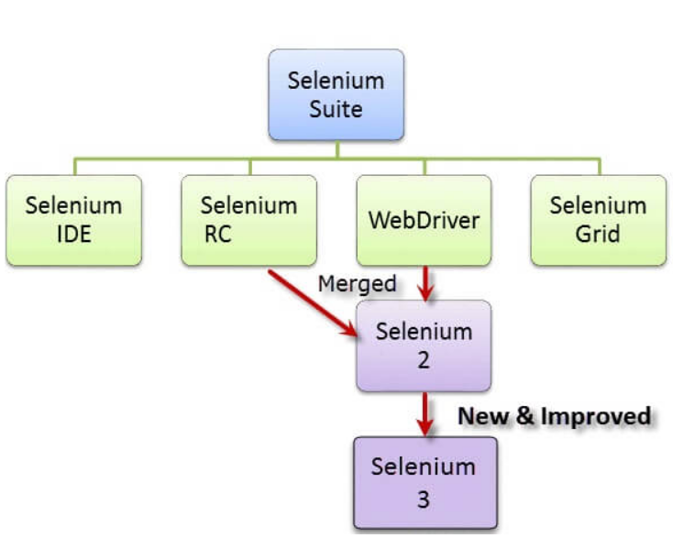

SELENIUM SUITE

Slide 6
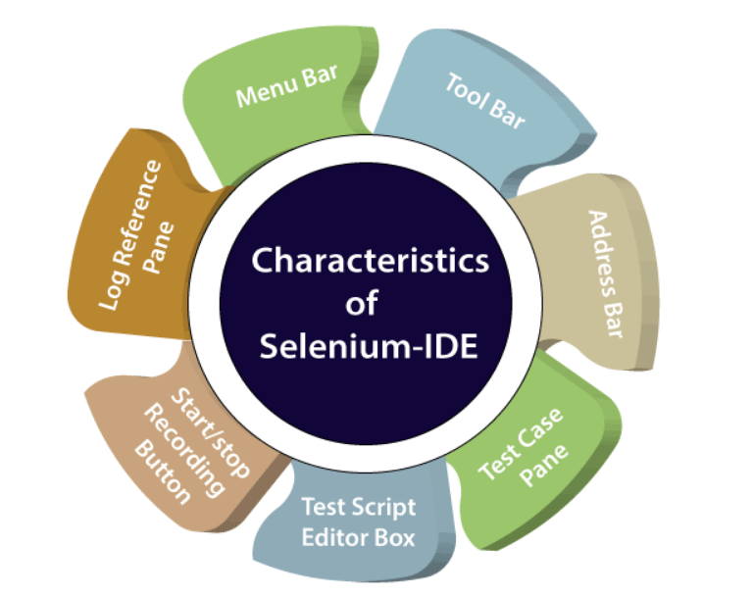
CHARACTERISTICS OF SELENIUM IDE
No Brittle Test
Reusable Tests / Modular Test Scripts
Scripts can be edited
Debug mode
Support for Embedded Code
Conditional Logics
Cross Browser
Parallel Execution
CI support
Code Repository
Visual Testing

Slide 7



MAILING ADDRESS
226/149 Nelson Street,
Auckland - 1010
REACH OUT
EMAIL ADDRESS
info@qexg.co.nz
PHONE NUMBER
0276410321 | 02108228425

